Slide 1
Computer Performance
Yuemin Ding
Tecnun, University of Navarra
Fall, 2021

Slide 2
Outline
Microprocessor speed
Performance balance
Multicores
Measures of computer performance

Slide 3
Microprocessor Speed
Over the years, the computing power of computers have been improved significantly.
The basic building blocks are almost the same as the IAS computer from 70 years ago.
Sophisticated techniques have been proposed to improve the computer performance.

Slide 4
Microprocessor Speed
The raw speed of the microprocess will not achieve its potential unless it is fed a constant stream of work to do.
Techniques that are used in contemporary processors to speed them up
  Pipelining
  Branch prediction
  Data flow analysis
  Speculative execution
  …

Slide 5
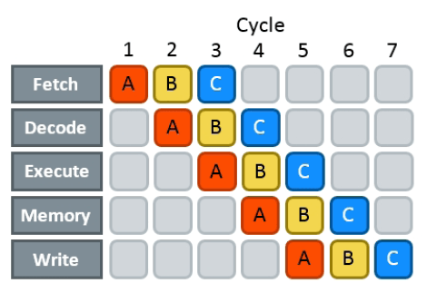
Microprocessor Speed
– pipelining
The execution of an instruction involves multiple stages of operation, such as fetching and decoding.
Pipelining enables a processor to work simultaneously on multiple instructions by performing a different phase for each of the multiple instructions.

Slide 6
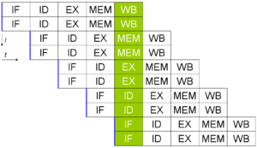
Microprocessor Speed
– superscalar execution
This is the ability to issue more than one instruction in every processor clock cycle.
In effect, multiple parallel pipelines are used.

Slide 7
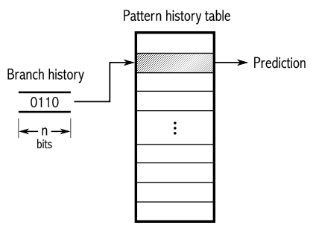
Microprocessor Speed
– branch prediction
The processor predicts which branches, or groups of instructions, are likely to be processed next.
If the processor guesses right most of the time, it can prefetch the correct instructions and buffer them

Slide 8
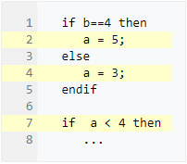
Microprocessor Speed
– data flow analysis
The processor analyzes which instructions are dependent on each other’s results, or data, to create an optimized schedule of instructions.

Slide 9
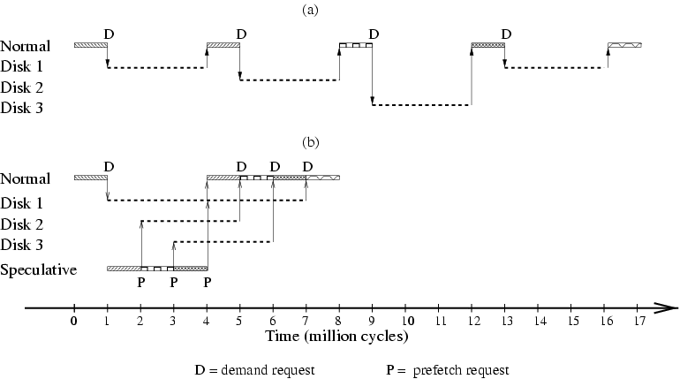
Microprocessor Speed
– speculative execution
Some processors speculatively execute instructions ahead of their actual appearance in the program execution, holding the results in temporary locations.

Slide 10
Outline
Microprocessor speed
Performance balance
Multicores
Measures of computer performance

Slide 11
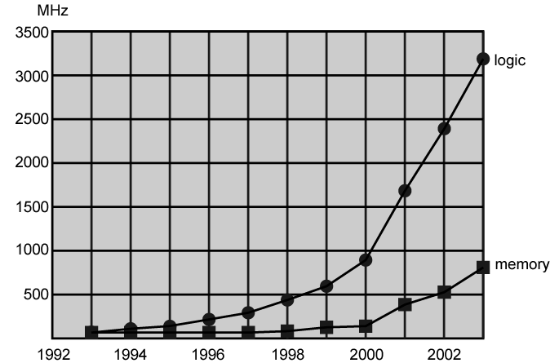
Performance Balance
Processor speed increased, but the others (memory, I/O, etc.) are not kept up.
The mismatch problem is particularly critical between processor and main memory.
Logic and Memory Performance Gap

Slide 12
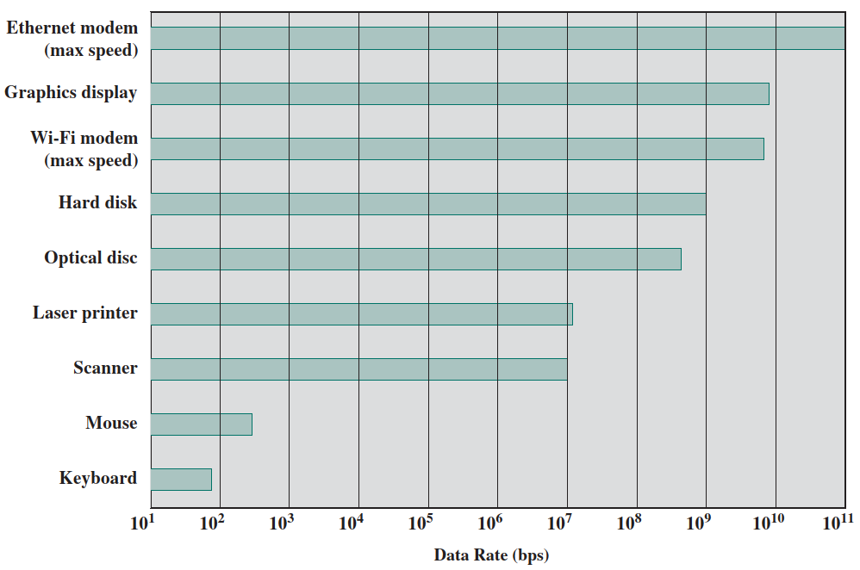
Performance Balance
Processor speed increased, but the others (memory, I/O, etc.) are not kept up.
Rough estimation of CPU processing speed: 4GHz×64bit=2.56×10¹¹bps
Logic and Memory Performance Gap

Slide 13
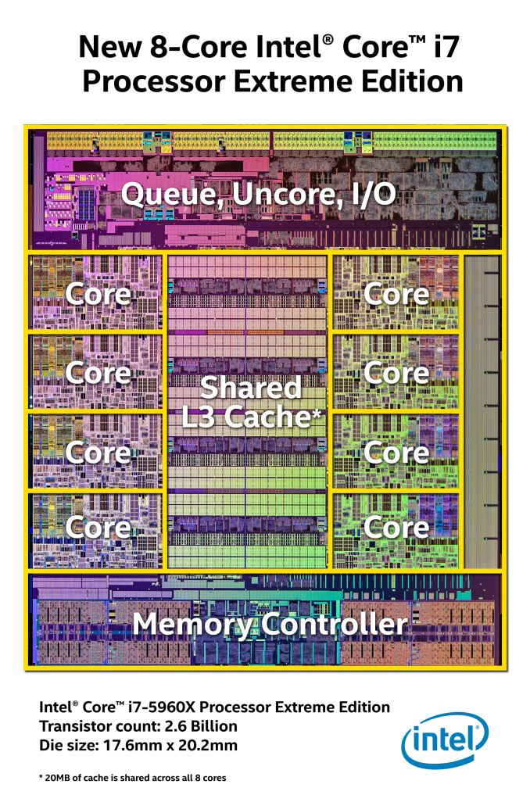
Reduce the Gap with Memory
Increase number of bits retrieved at one time
  Make memory cell “wider” rather than “deeper”
Change memory interface, for example:
  Including cache memory
Reduce frequency of memory access
  More complex cache and cache on chip
Increase interconnection bandwidth
  High speed buses
  Hierarchy of buses

Slide 14
Reduce the Gap with I/O
Problem moving data between processor and peripheral
Solutions:
  Caching
  Buffering
  Higher-speed interconnection buses
  More elaborate bus structures
  Multiple-processor configurations

Slide 15
Balance is Key
Designers try to balance the throughput and the processing demands of:
  Processor components
  Main memory
  I/O devices
  Interconnection structures

Slide 16
Outline
Microprocessor speed
Performance balance
Multicores
Measures of computer performance

Slide 17
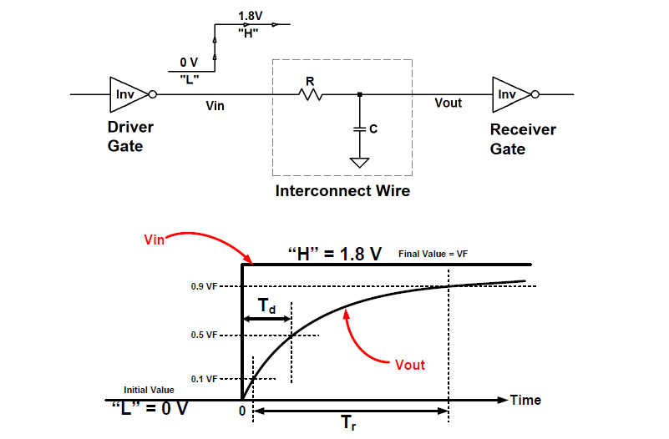
Multiple Cores
The need to increase processor speed remains
However, the increasing of clock speed and logic density is facing obstacles by power, RC delay, memory latency and throughput, etc.
Within a core, increase in performance is more and more difficult
RC delay

Slide 18
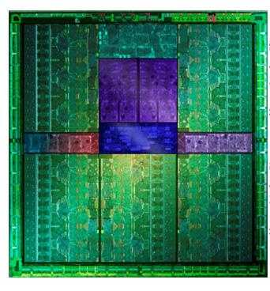
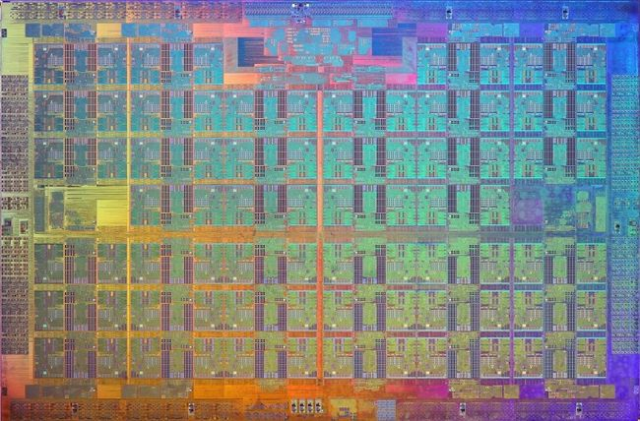
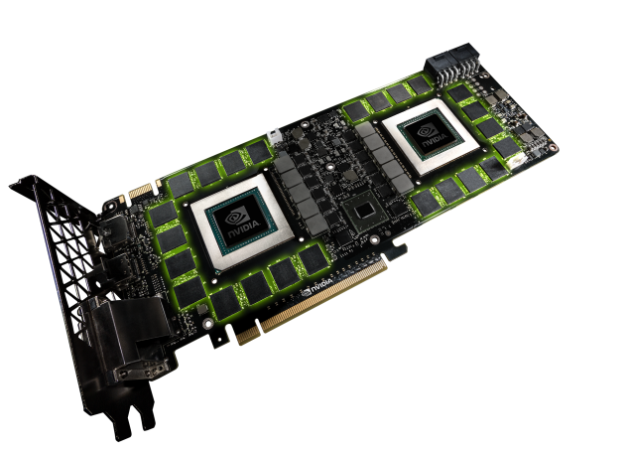
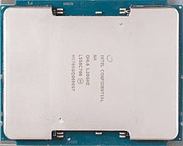
Multiple Cores
Solution: use two simpler processors on the chip rather than one more complex processor
Many integrated core (MIC)
Intel integrates 76 cores into a single chip
Graphics processing unit (GPU)
Nvida integrates 5760 CUDA cores into their GPU
Intel Xeon Phi, Knights Landing
Nvidia GeForce GTX Titan-Z

Slide 19
Outline
Microprocessor speed
Performance balance
Multicores
Measures of computer performance

Slide 20
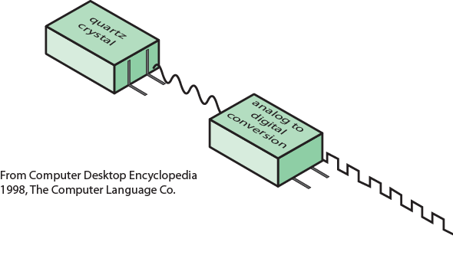
Basic measures - Clock Speed
System clock speed=“clock rate”=“frequency”
  In Hz or multiples of Hz
  cycle time=(1/clock rate)
Clock speed is not the whole story about performance
  Some instructions may take only a few cycles, while others require dozens.
  When pipelining is used, multiple instructions are being executed simultaneously.

Slide 21
Measures of Computer Performance
Related definitions:
  Millions of instructions per second (MIPS)
  Millions of floating point instructions per second (MFLOPS)
  Cycles per Instruction (CPI)
  Processor Time (T)
  NOTE! Performance terms are heavily dependent on instruction set, compiler design, processor implementation, cache & memory hierarchy

Slide 22

Overall CPI (Cycles Per Instruction)
If the number of clock cycles required varies for different types of instructions, the overall CPI is:
: number of cycles required for instruction type i
: number of executed instructions of type i
: number of machine instructions executed

Slide 23

MIPS Rate
Rate at which instructions are executed, expressed as MIPS (millions of instructions per second):
: number of machine instructions executed
: CPU time (execution time)
: overall cycles per instruction
: CPU frequency (Hz)

Slide 24
MFLOPS Rate
Another common performance measure deals only with floating-point instructions.
It’s the MFLOPS rate:

Slide 25
Processor time
Processor time (or CPU time), T, needed to execute a given program can be expressed as:
: number of machine instructions executed
: overall cycles per instruction
: cycle time

Slide 26
Benchmarks
Measures such as MIPS and MFLOPS have proven inadequate to evaluating the performance of processors.
Because of differences in instruction sets
Programs designed to test performance:
  Written in high level language
    Portable
E.g. System Performance Evaluation Corporation (SPEC)
  SPEC CPU® 2017
    10 floating point programs in C, C++, Fortran
    10 integer programs in C, C++

Slide 27
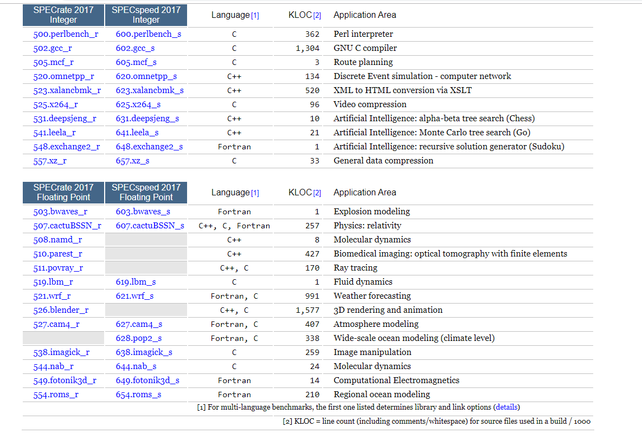

SPEC CPU® 2017
https://www.spec.org/cpu2017/Docs/index.html#intspeed
Notes:
K lines of code

Slide 28

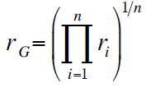
SPEC Speed Metric
Base runtime defined for each benchmark using reference machine
Results are reported as ratio of reference time to system run time
  Tref_{i} execution time for benchmark i on reference machine
  Tsut_{i} execution time of benchmark i on test system
Overall performance calculated by averaging ratios for all 12 integer benchmarks
  Use geometric mean
    Appropriate for normalized numbers such as ratios

Slide 29
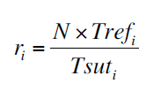
SPEC Rate Metric
Measures throughput or rate of a machine carrying out a number of tasks
Multiple copies of benchmarks run simultaneously
  Typically, same as number of processors
Ratio is calculated as follows:
  Tref_{i} reference execution time for benchmark i
  N number of copies run simultaneously
  Tsut_{i} elapsed time from start of execution of program on all N processors until completion of all copies of program
  Again, a geometric mean is calculated for overall performance

Slide 30
Thank you!
Q&A

